Slide 1
Unit 1-part I. Working with Files in Java
DATA ACCESS 18/19

Slide 2
UNIT 1. INDEX
PART I
CLASSES FOR ACCESSING FILES
STREAMS
WORKING WITH XML FILES
ACCESS TO XML FILES WITH DOM
PART II
ACCESS TO XML FILES WITH SAX
PART III
ACCESS TO XML FILES WITH JAXB
PART IV
PROCESSING XML WITH XPATH

Slide 3
1.CLASSES FOR ACCESSING FILES
https://docs.oracle.com/javase/tutorial/essential/io/file.html
https://www.tutorialspoint.com/java/java_files_io.htm
In java io:
BufferedReader, BufferedWriter
InputStreamReader,OutputStreamReader

Slide 4
1.CLASSES FOR ACCESSING FILES
Java has several classes to work with files,
These files can be of different types:
• Depending on the content:
– Characters files
– Binary files.
• Depending on the access mode:
– Sequencial files.
– Random files.
We can use the class File to create or access files:
File f= new File(“libros.xml”);

Slide 5
2.STREAMS
In Java, the access to files is treated as a stream of information between the program and the file.
A stream can be defined as a sequence of data. There are two kinds:
InPutStream − used to read data from a source.
OutPutStream − used for writing data to a destination.
Streams are typically connected to a data source or destination, like a file, network connection etc.
IO streams are typically byte based. This means that you can either read bytes from, or write bytes to a stream. You can use FileInputStream and FileOutputStream classes.
If you need to read / write characters ( like UNICODE characters ), you should use a FileReader ,BufferReader or FileWriter ,PrintWriter classes.
For random files, you can use RandomAccessFile

Slide 6
2.1Example
See document ExampleFileAcces.doc

Slide 7
3. WORKING WITH XML FILES
XML is a markup language for marking up the structure of a text document.
XML is a text file, but with “more meaning”, We will treat XML files with specific technologies.
Tools for XML can do different things:
Check that the XML is well-formed:
DOM
SAX
Other tools validate the xml according to the xml schema:
JAXB
Query xml files.
XPATH

Slide 8
XML with Java
http://www.ntu.edu.sg/home/ehchua/programming/java/j6d_xml.html
To process the data contained in XML documents, you need to write an application program (in a programming language such as Java, JavaScript). The program makes use of an XML parser to tokenize and retrieve the data/objects in the XML documents. An XML parser is the software that sits between the application and the XML documents.
The parser reads a raw XML document, ensures that is well-formed, and may validate the document against a DTD or schema.
There are two standard APIs for parsing XML documents:
DOM (Document Object Model)
SAX (Simple API for XML)

Slide 9
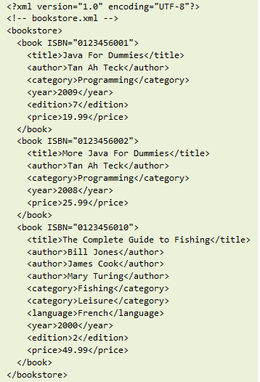
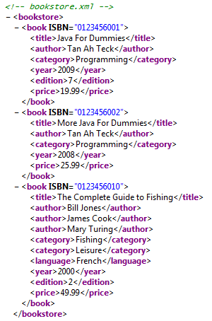
EXAMPLE of XML file

Slide 10
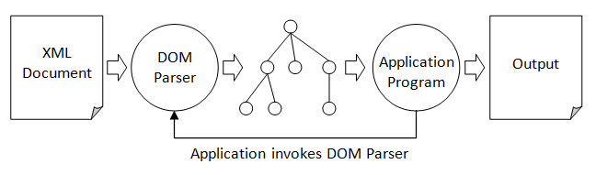
4. ACCESS TO XML FILES WITH DOM

Slide 11
DOM
DOM is an object-oriented API. The DOM parser builds an object model, in the form of a tree structure, to represent an XML document. The tree is kept in main memory, with all the father, child and sub-child nodes.
DOM methods access the different nodes and analyze the type of node to obtain the information from them.
Afther the DOM tree is generated, our application can then manipulate the nodes in the tree.
DOM is a platform- and language-independent interface for processing XML documents.
The DOM API defines the mechanism for querying, traversing and manipulating the object model built.
Comment: If the xml file is big, the tree generated can be too big to create and handle in main memory.

Slide 12
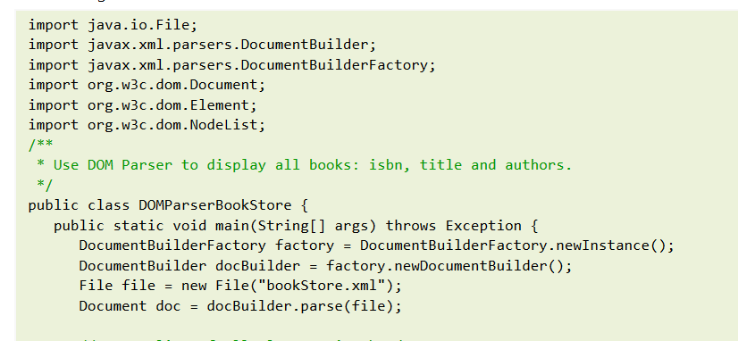
Example of application using DOM from www.ntu.edu.sg...

Slide 13
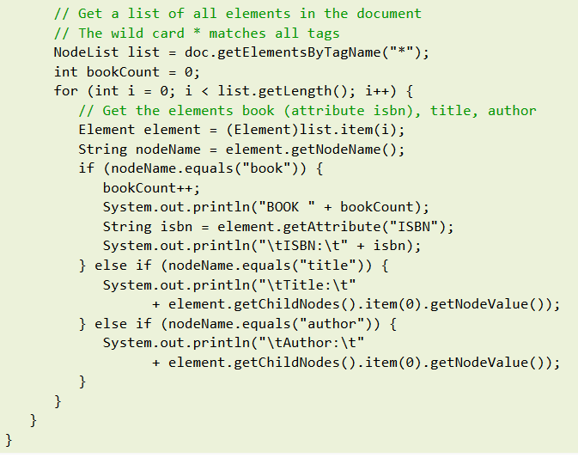

Slide 14
EXAMPLE: BOOKS.XML
Install editix.?
File Books.xml
<?xml version="1.0" encoding="UTF-8"?>
<Books xmlns:xsi="http://www.w3.org/2001/XMLSchema-instance" xsi:noNamespaceSchemaLocation=“Books.xsd">
<Book publicado_en="1894">
<Title>The Jungle Book</Title>
<Author>Rudiard Kipling</Author>
</Book>
<Book publicado_en="2003">
<Title>The Da Vinci Code</Title>
<Author>Dan Brown</Author>
</Book>
<Book publicado_en="1981">
<Title>The name of the Rose</Title>
<Author>Umberto Eco</Autor>
</Book>
<Book publicado_en="1605">
<Title>Don Quixote</Title>
<Author>Cervantes</Author>
</Book>
</Books>

Slide 15
DOM example
Notes: if the class OutputFormat gives an error , you must solve it→see word document.
What can we do:
Open DOM
Traverse DOM
Modify and serialize DOM
We will use classes in the packages:
org.w3c.dom,
javax.xml.parsers (standard API)
javax.xml.transform
Classes:
Document
DocumentBuilder, (its method parse() creates the DOM tree)
DocumentBuilderFactory

Slide 16
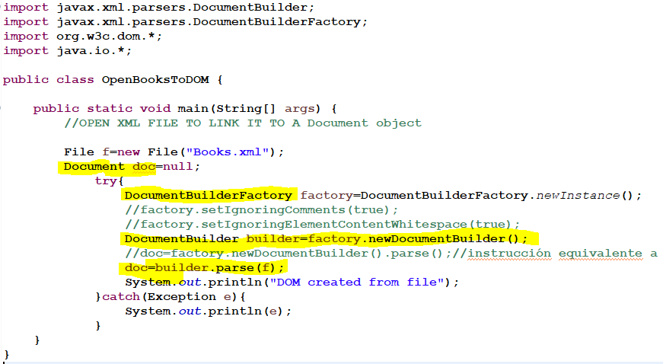
Example: OpenBooksToDOM

Slide 17
import javax.xml.parsers.DocumentBuilder;
import javax.xml.parsers.DocumentBuilderFactory;
import org.w3c.dom.*;
import java.io.*;
public class OpenBooksToDOM {
public static void main(String[] args) {
//OPEN XML FILE TO LINK IT TO A Document object
File f=new File("Books.xml");
Document doc=null;
try{
DocumentBuilderFactory factory=DocumentBuilderFactory.newInstance();
//factory.setIgnoringComments(true);
//factory.setIgnoringElementContentWhitespace(true);
DocumentBuilder builder=factory.newDocumentBuilder();
//doc=factory.newDocumentBuilder().parse();//instrucción equivalente
doc=builder.parse(f);
System.out.println("DOM created from file");
}catch(Exception e){
System.out.println(e);
}
}
}

Slide 18
PRACTICES1,2,3, 4: working with DOM
Create a class with all the methods for the DOM tree:
class AccessXMLDOM
Methods:
PRACTICE 1: openXMLtoDOM (File f):
PRACTICE 2: traverseDOMandShow PRACTICE 3: adding and deleting nodes in the DOM tree
PRACTICE 4 : saveDOMasFile: (HERE)

Slide 19
Extra Practice 1.
https://www.java-tips.org/java-se-tips-100019/46-org-w3c-dom/440-accessing-different-types-of-dom-tree-nodes.html
Accessing different types of DOM tree nodes
/** determine the types of DOM-nodes and printing their specific contents.
*/

Slide 20
Exercises: DOM

Slide 21
5. SAX
See UNIT 1-PART 2

